Slide 1
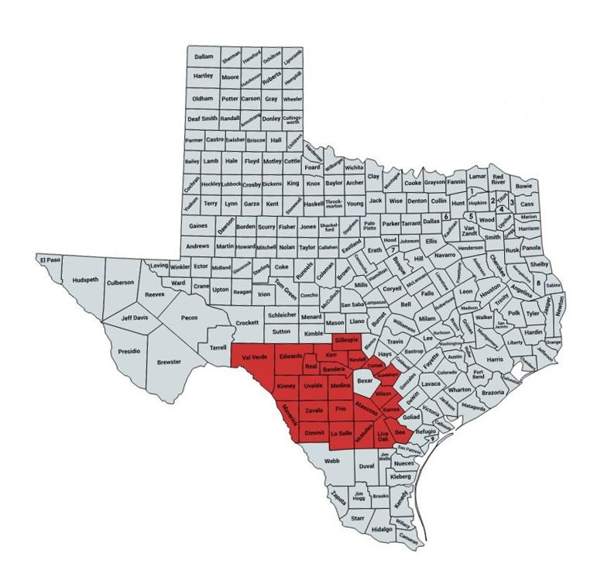
Service Area
WIC Program
This program provides one-on-one nutrition education, USDA regulated food benefits, breastfeeding promotion, and referrals to other services.
Community Action changes people’s lives, embodies the spirit of hope, improves communities, and makes America a better place to live. We care about the entire community and we are dedicated to helping people help themselves and each other.
Community Council of South Central Texas, Inc.
801 N. State Hwy 123 Bypass
Seguin, Texas 78155
Phone: 830.303.4376
Fax: 830.372.5354
www.ccsct.org
www.facebook.com/ccsctinc

Slide 2
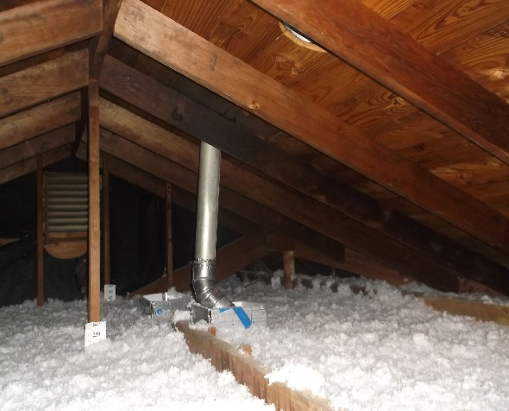
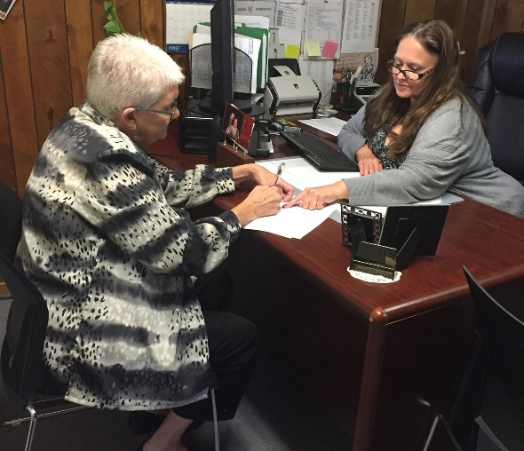
Utility Assistance Program
This program helps low-income consumers reduce their utility bills. Services include utility payment assistance, energy education and budget counseling.
Rental Assistance Program
This program helps low-income families obtain affordable housing and includes payment of rental subsidies and security and utility deposits.
About us
CCSCT is a non-profit community action agency that empowers vulnerable families and individuals in greater South Central Texas to achieve self-sufficiency by eliminating barriers through innovative programs and strong community partnerships.
Our agency currently provides services in 23 counties in South Central Texas.
Weatherization Program
This program provides assistance to low-income households and identifies weatherization measures to reduce high utility bills.
Other Agency Programs and Services Include:
Case Management
Referral Services
Disaster Relief

